Slide 1
Airway Management & Assessment EMS TEAM
MWLC EMSS 10-2024

Slide 2

News You can use
MWLC EMSS Policies have been updated
Policies can be found on the MWLC EMSS website
https://www.nm.org/for-medical-professionals/emergency-medical-services-northwest-suburbs
When exchanging controlled substances please double check the doses and concentrations you are receiving.
Restrict the use of IV fluids to those patients requiring volume replacement until the shortage resolves. (See memo)

Slide 3
Disclaimer
Some images used within this Power Point presentation have taken
from Google and are being used for the sole purposes of education
under the presumption of “Fair Use” doctrine or act. It is not the
intention of the author or presenter to reproduce, sell, manufacture or
recreate any of these images.

Slide 4
Objectives
ALS OBJECTIVES
BLS OBJECTIVES
Review the design and use of air traq laryngoscopy equipment.
Review the design and use of needle cricothyrotomy equipment.
Competency needle cricothyrotomy procedures.
Review physiology of both the adult and pediatric airway.
Review normal and abnormal airway assessment findings.
Discuss the value of serial capnography assessment evaluations.
Identify triggers for airway intervention.
Demonstrate BLS airway procedures.

Slide 5
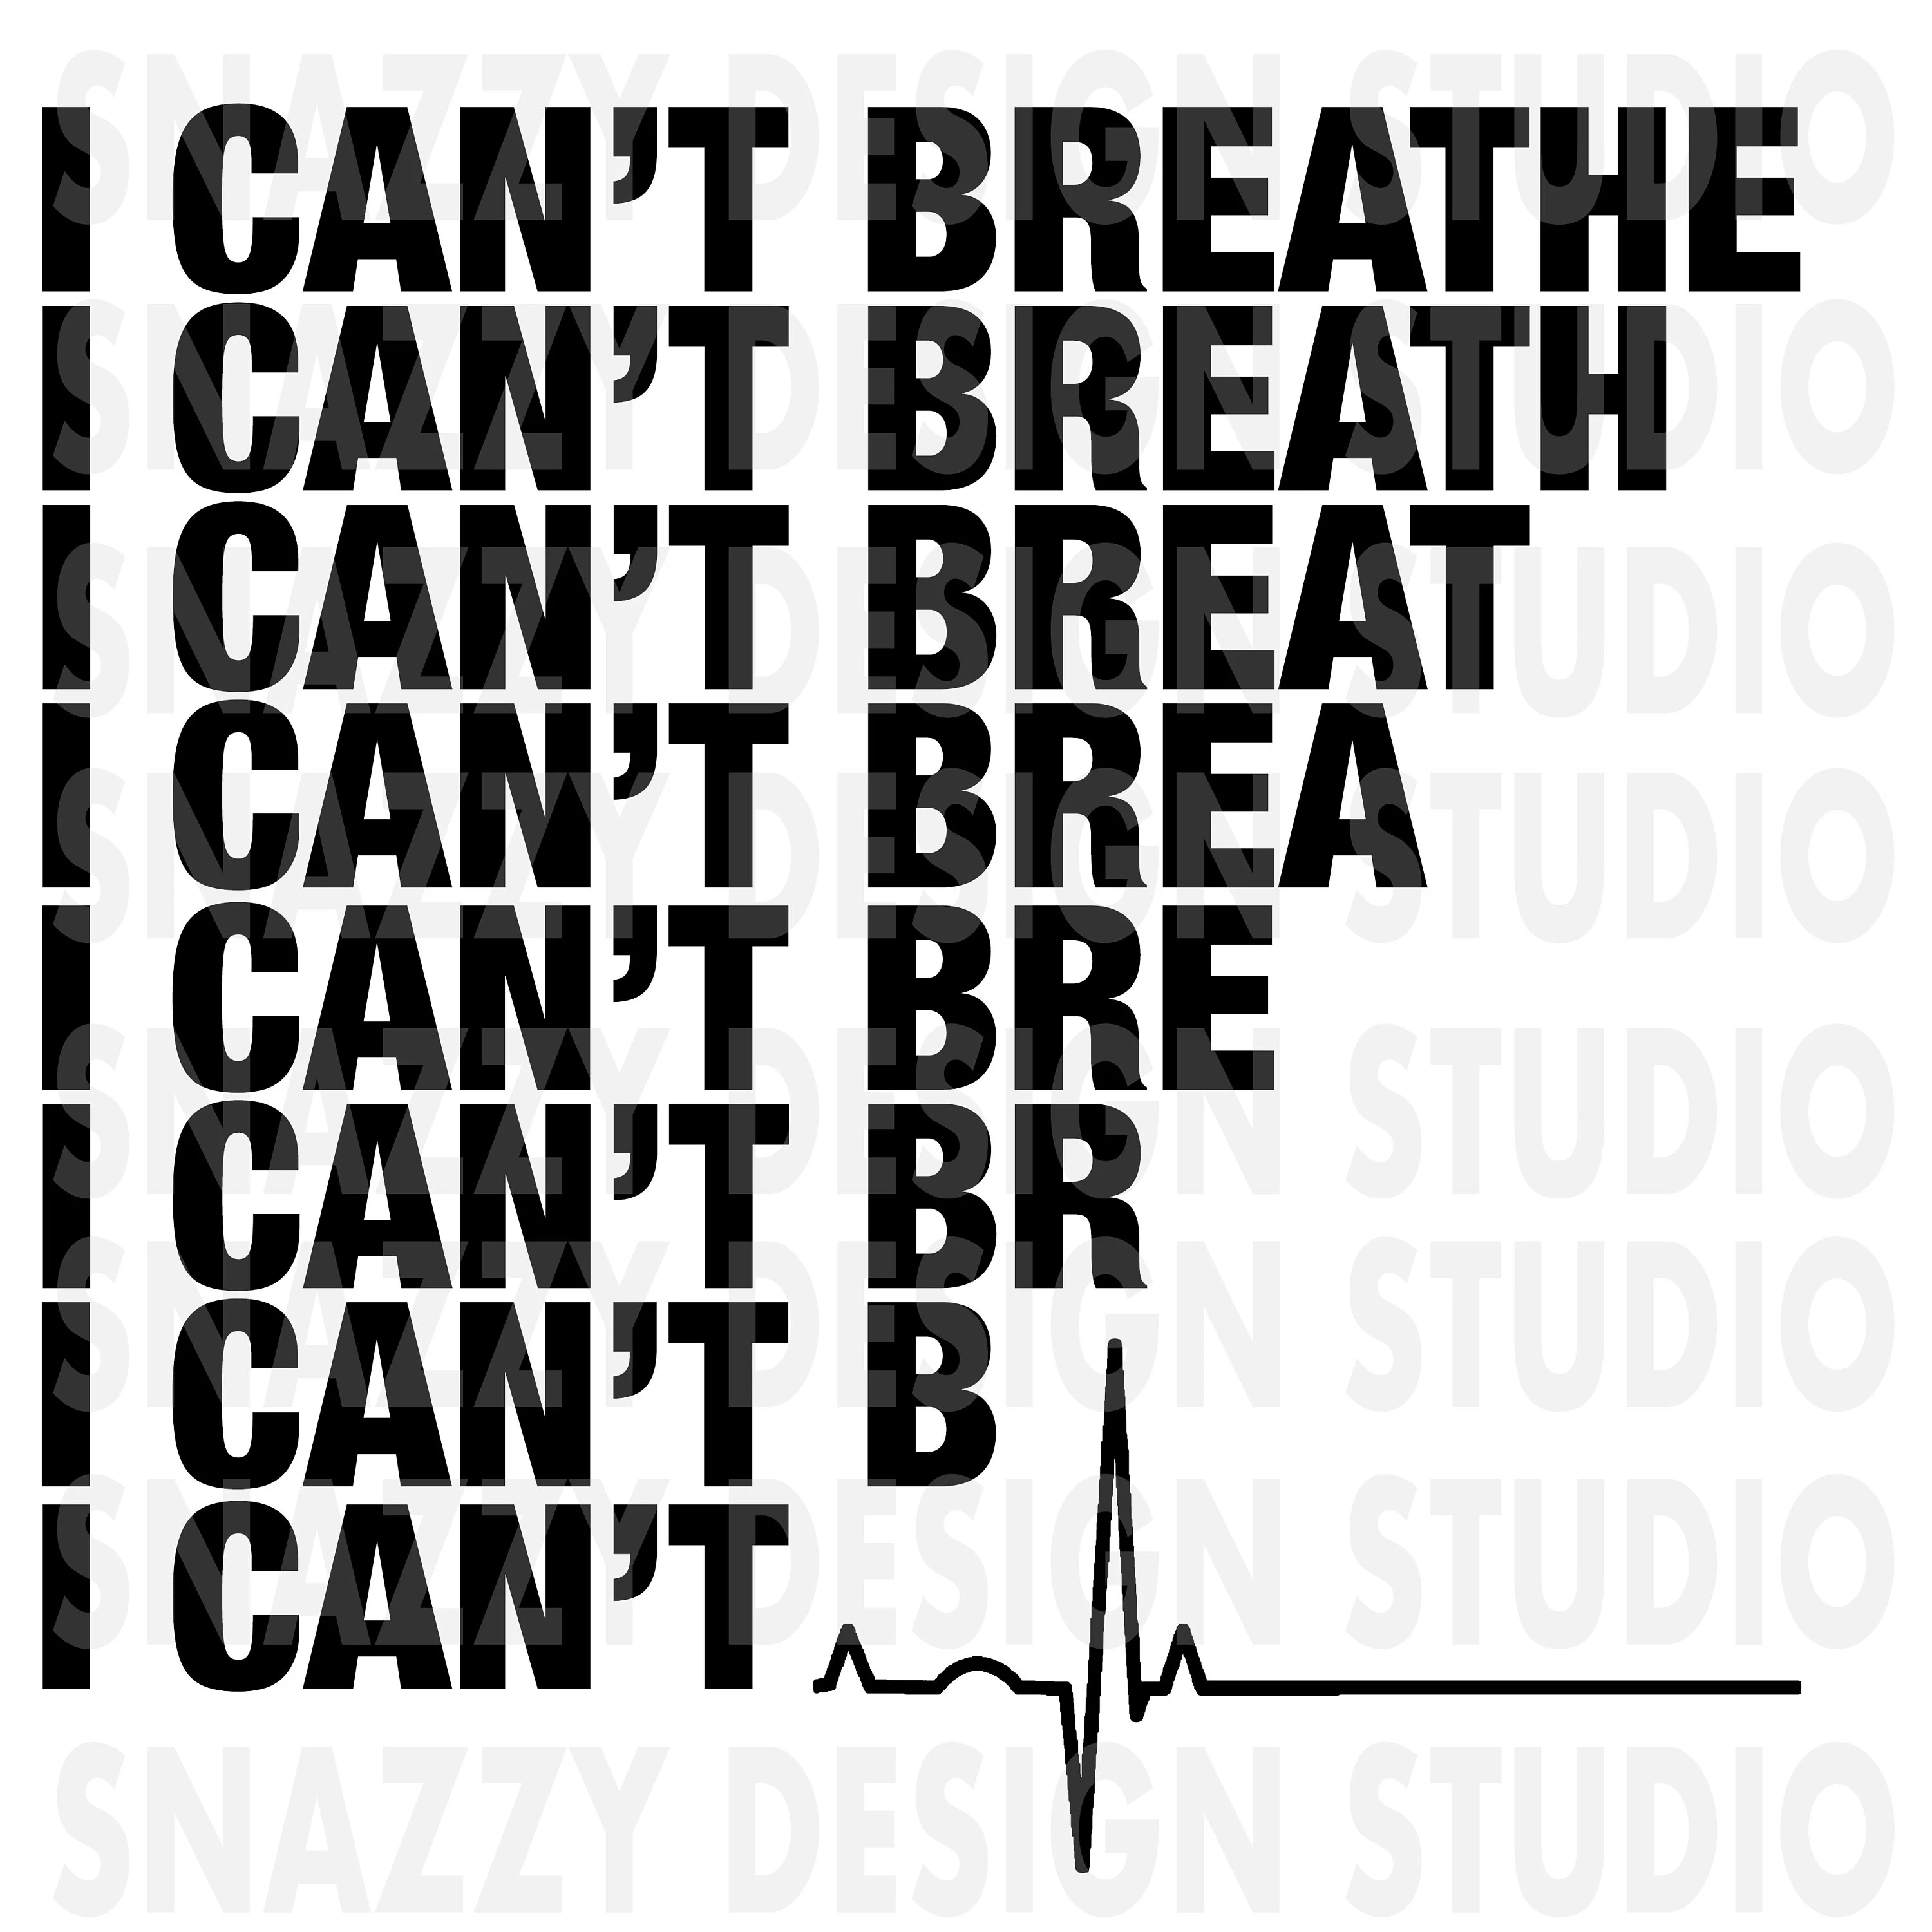
Respiratory Distress
Causes Treatment
ACS/HF Suctioning
Asthma COPD Airway: OP/NPA,ET,
Choking FBAO Albuterol/ipratropium
Infection Levophed
PE Epinephrine
MSK IVF
Pneumothorax Midazolam
NTG
Notes:
Possible causes and possible treatment Ask the crowd for each cause what is the treatment….. They are not in order, and there can be more than one treatment for each cause

Slide 6
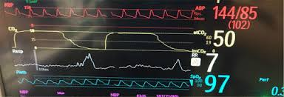

How is respiratory FAILURE different?
Respiratory FAILURE is:
Hypoxia despite O2
Hypercarbia ( ETCO2)
Notes:
This is a normal wave form, but bring home the point of what is the Number value

Slide 7
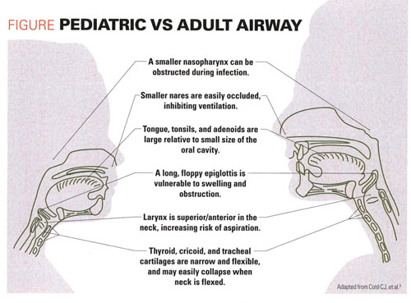
Adult
Larynx is cylindrical
Glottic opening is narrowest point
Anatomic differences
Pediatric
Funnel shape larynx
Subglottis is the narrowest part
Large tongue & head
Small mandible
Larynx is high
Epiglottis is long and stiff
Vocal cords angled
Notes:
Different theories on cuffed vs uncuffed tubes for pediatrics: Cuffed is preferable for decreased air leak. Uncuffed tubes can cause laryngospasm, may cause tissue necrosis in prolonged intubations. Although in EMS this may not be practical since sizing the tube correctly for pediatrics is HUGE. NO WE DO NOT INTUBATE PEDIATRICS This is why we use an IGEL.

Slide 8
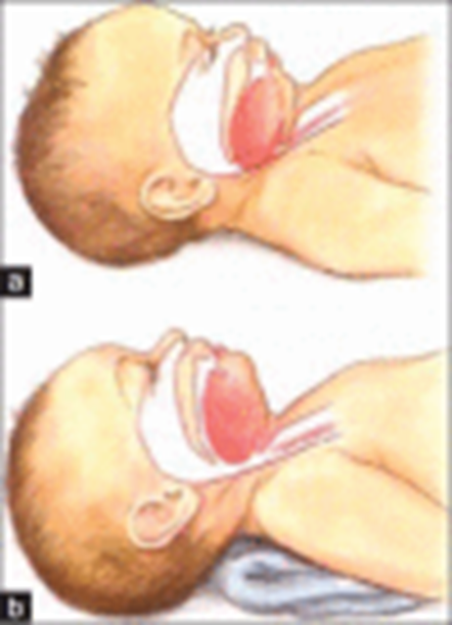
Positioning is crucial
Note the large occiput which causes flexion > tongue obstructs airway
Obstruction relieved by placing towel under shoulders allowing extension of the head > opening airway
Notes:
Simple BLS skills to help manage a pediatric airway, this is the position for BVM, and placing of an IGEL Set yourself up for success by positioning the patient

Slide 9
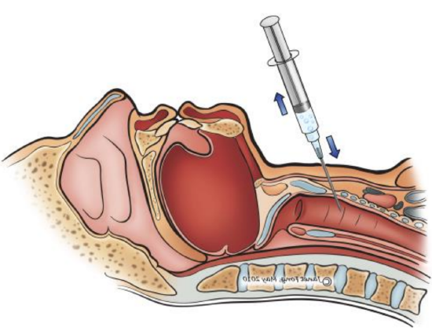
Needle Cricothyrotomy
Re-Introducing the Needle Cricothyrotomy
Only to be used as a rescue airway
Short term use no more than 30 minutes
Once placed transport to the closest ED
To be used for
Adults
Pediatrics
Notes:
This is a time sensitive patient, as this is a rescue airway that is only good for 30 minutes. :)

Slide 10
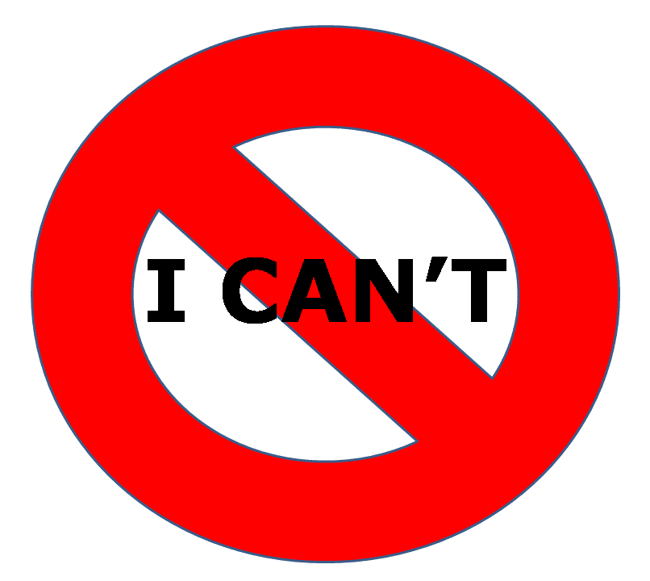

Needle Cricothyrotomy
INDICATIONS
Cannot Intubate
Cannot insert I Gel
Cannot ventilate
Contraindications
Inability to identify landmarks
Tracheal transection or severe trauma
When used as a rescue airway no absolute contraindications
Very small children false placement is common
excessive bleeding
Notes:
Instead of US telling them when to do this procedure, ask the room when would you need a needle cric? EMS will always want black and white and it simply is not possible with this topic

Slide 11
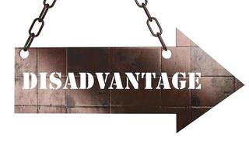
Does not allow for good elimination of C02
C02 accumulates rapidly (expect this)
Requires one person to monitor CONSTANTLY
Ineffective tidal volume r/t size of needle
Temporary relief 30-40 min
Does not protect airway from aspiration
Unable to suction through
IT IS INVASIVE
Is to be used as only a LAST RESORT
Notes:
Take some time to discuss capnography and what would they expect? It is a 10 Gauge needle and the patient WILL be retaining CO2. What happens to people who retain CO? They can develop Carbon Dioxide Narcosis which may lead to a depressed level of consciousness, coma, and ultimately death

Slide 12
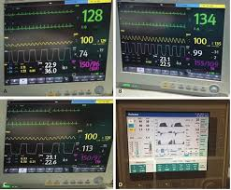

Hypercapnia
Excess CO2 in body
Caused by any condition that prevents CO2 from getting out of your body
Use capnography to monitor
Keep transport time short
AKA
Ventilating through a 10 G needle into the trachea will allow a small volume of O2 to pass to the lungs
Difficult to exhale through a 10G needle
This causes an increase in CO2 = elevated capnography number
TREND THESE NUMBERS
Notes:
Ask the class if they can name conditions that prevent C02 from being removed from the body. Not just ventilation…
Take am moment to touch on Capnography in the most basic sense Metabolic, Perfusion & Ventilation. (MVP) Hypercapnia is the high levels of CO2 in your blood. CO2 builds up because the ability to exhale is problematic – This is the reason that EMS must monitor capnography during this procedure to trend values. Hypercapnia unchecked will lead to CO2 Narcosis the delineating feature of CO2 narcosis== a depressed level of consciousness. This may be difficult to realize with a needle cric as sedation may or will be on board. It is VERY important to trend Capnography, and this is a time sensitive patient who needs fast intervention. A needle cric should be the life saving treatment to get the patient to an ED who can then place an airway, including Woodstock. Preferably within 30 min or less

Slide 13
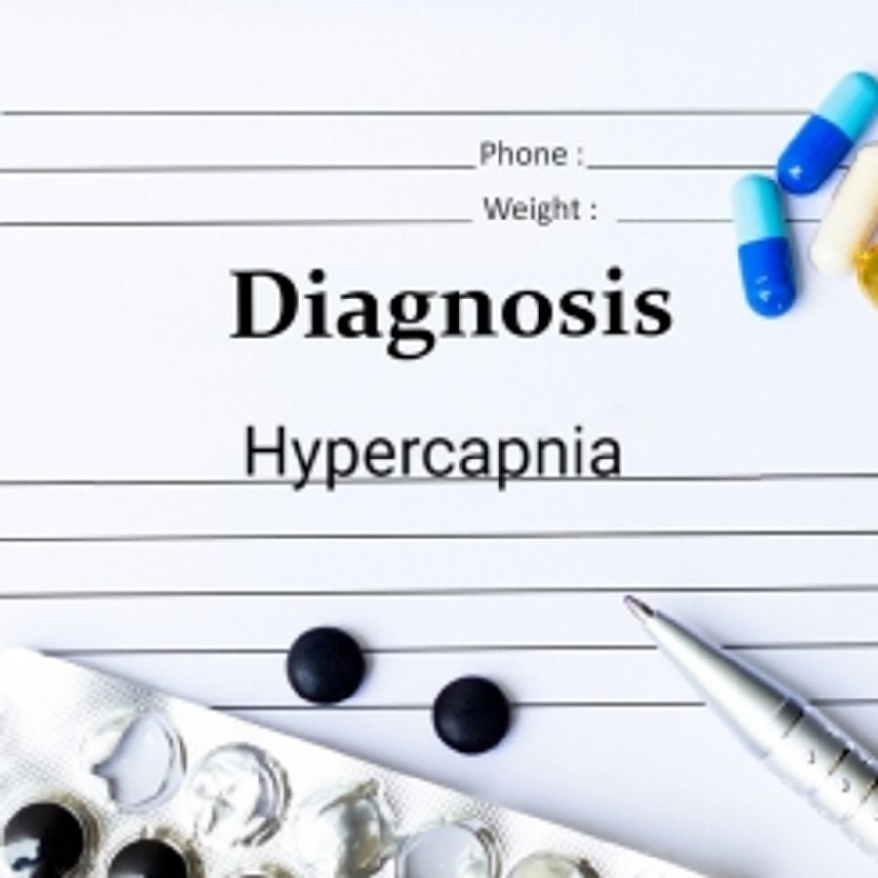
Check for understanding
Which definition of hypercapnia is correct?
1. Beginning of rapid, deep breathing
2. Presence of slow, shallow breathing
3. Decreased oxygen level in the blood
4. Increased carbon dioxide in the body
Notes:
Answer is 4

Slide 14

Questions to ask yourself
Could you attempt manual maneuvers for opening upper airway?
Could you attempt direct visualization?
A needle cric is truly the last resort?
Notes:
In some cases none of this will apply but it is good to make sure this is an appropriate time for this skill. I want them to ask themselves these questions

Slide 15
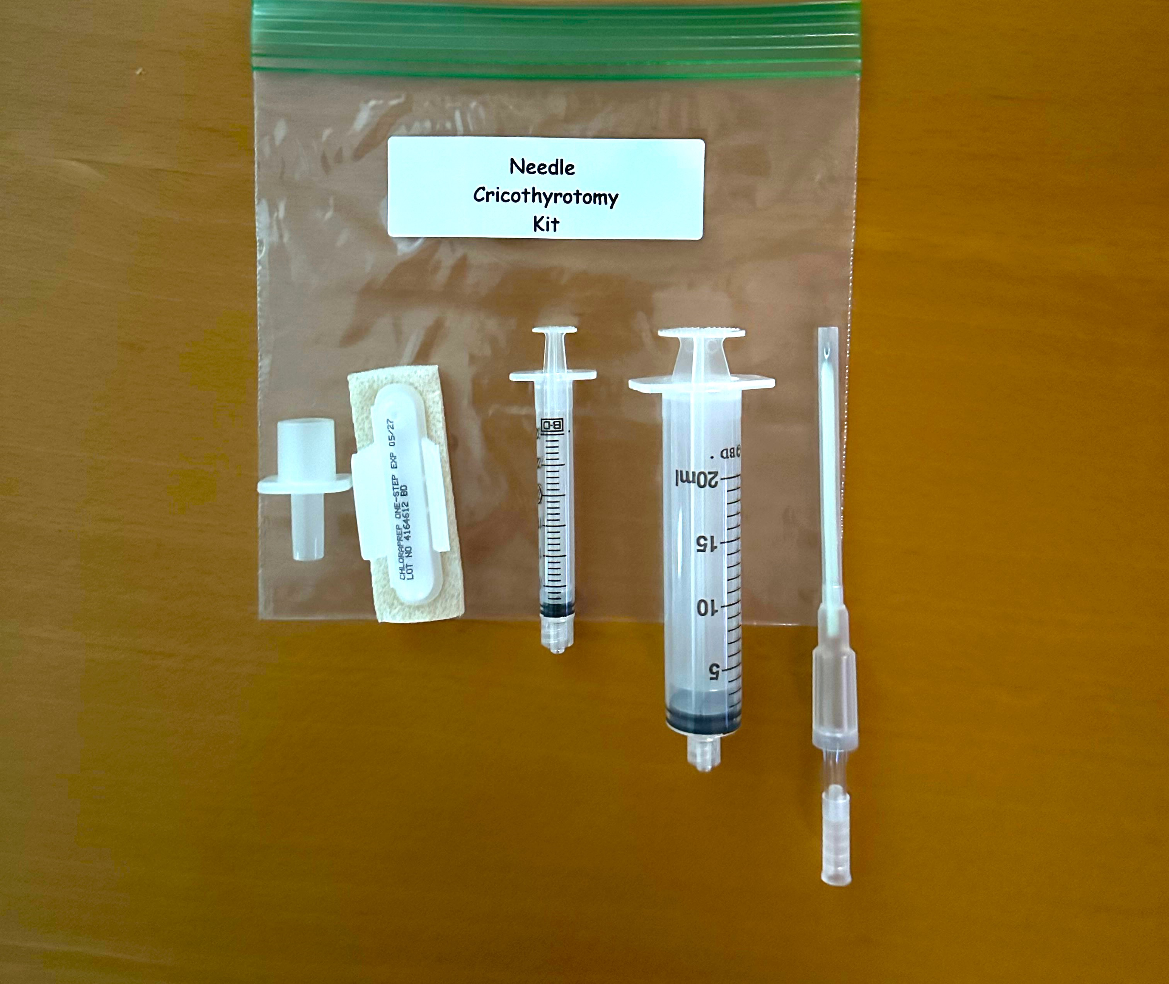
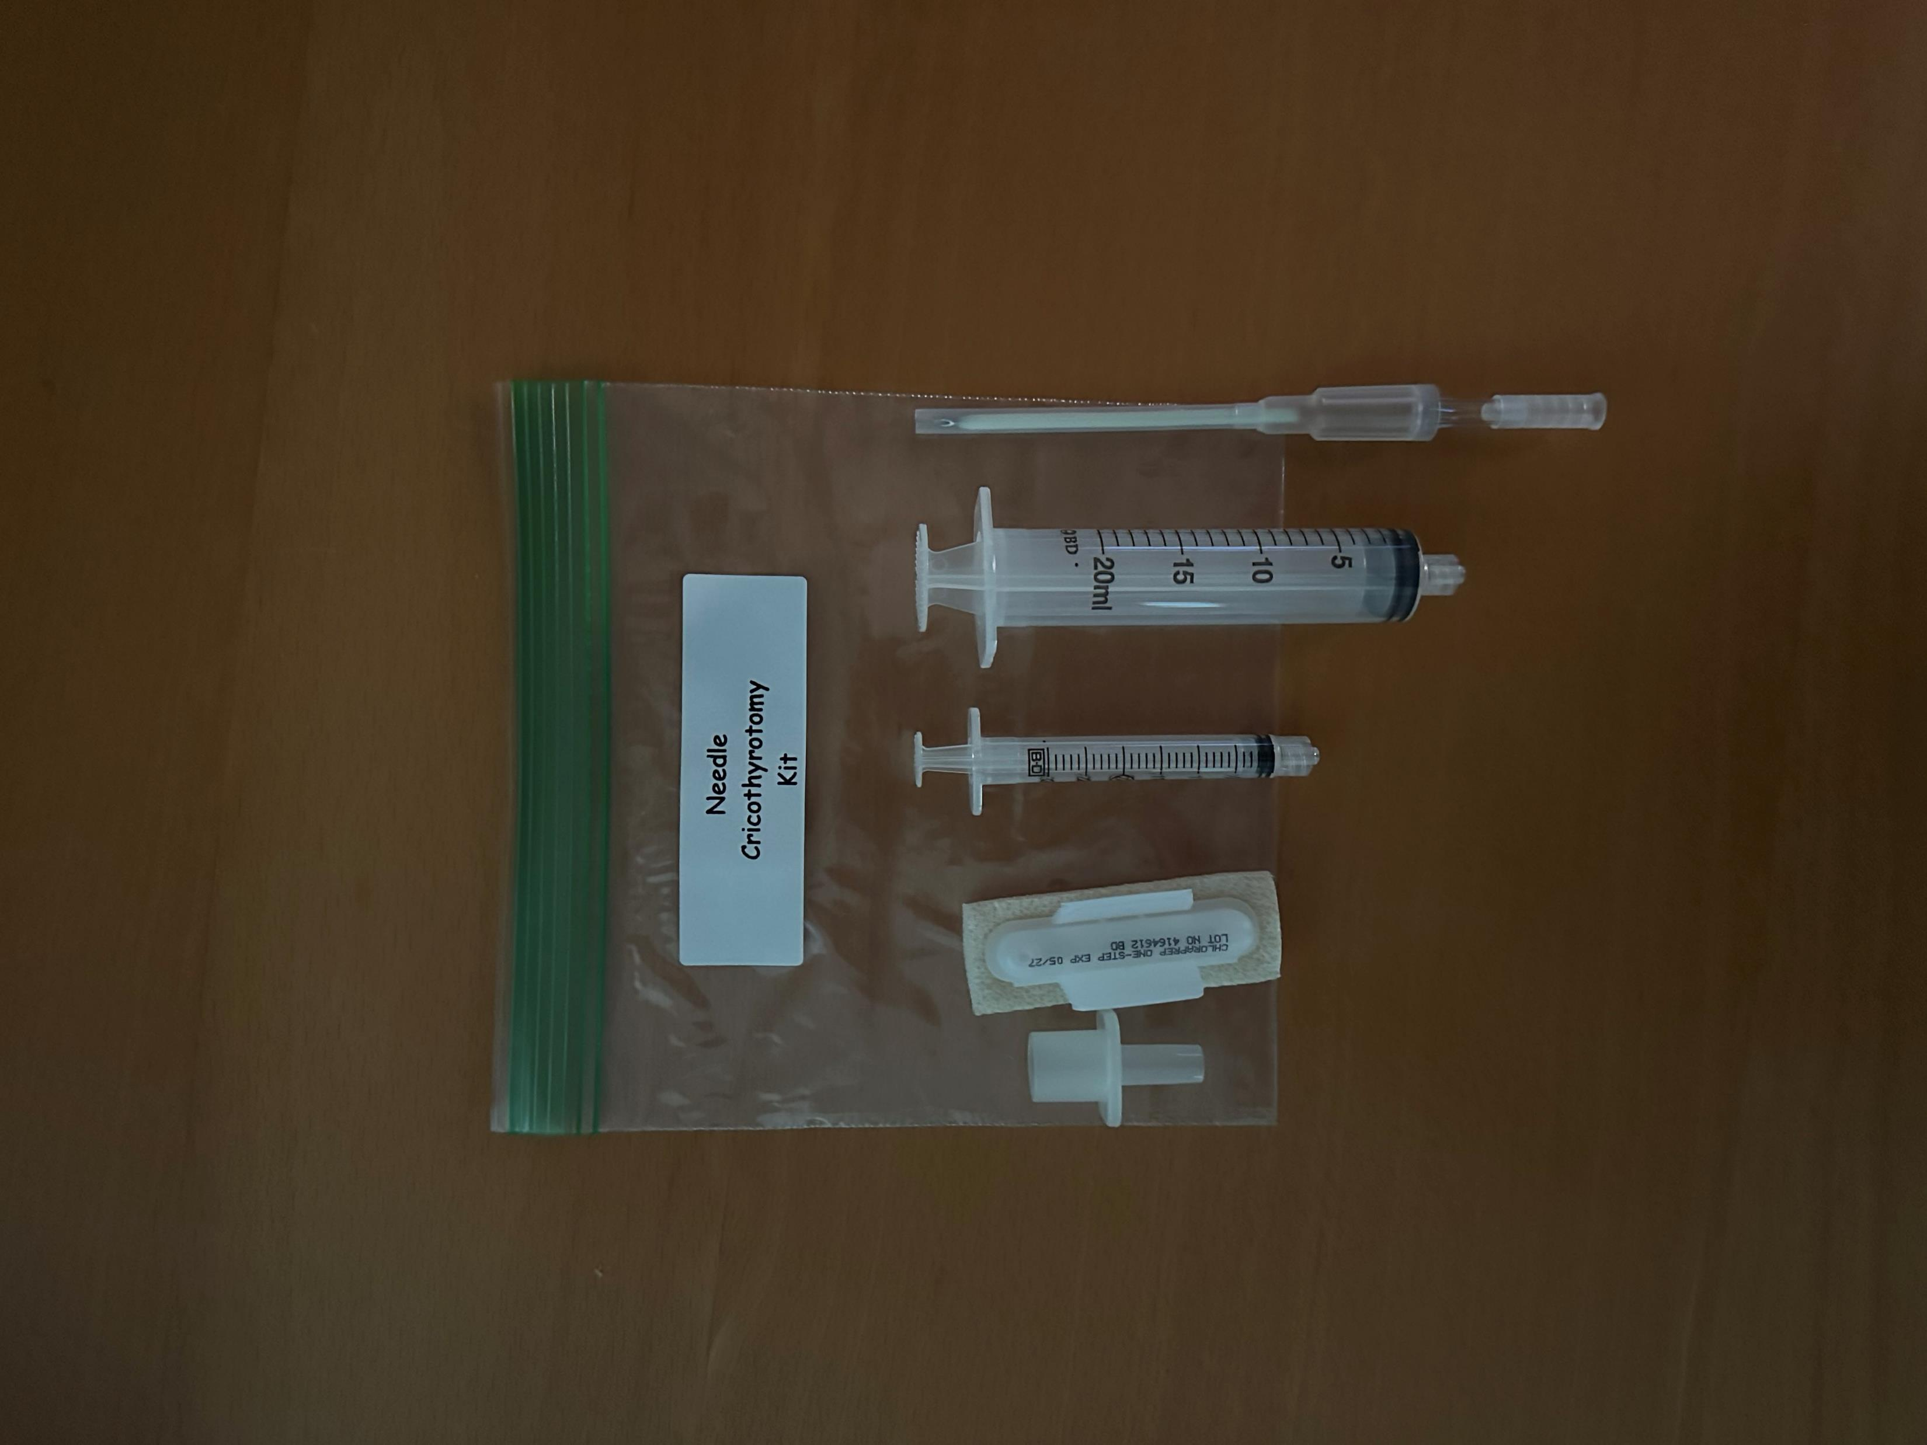
MWLC EMSS Needle Cricothyrotomy Kit
Notes:
These will be put together and delivered to the departments once complete training has been done.

Slide 16
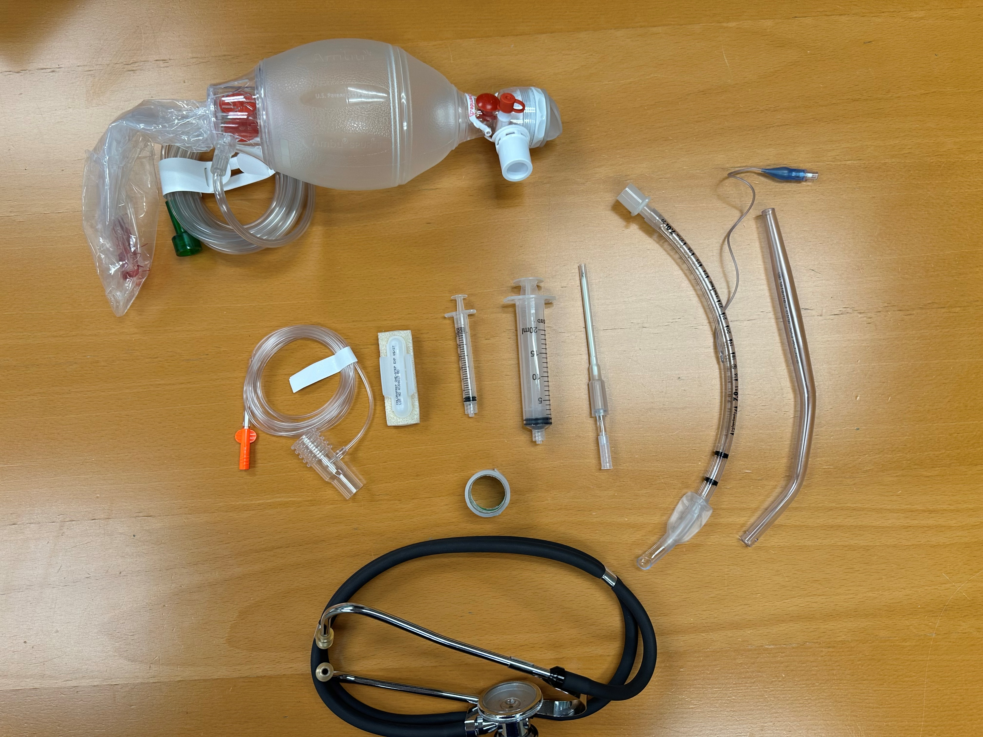
Equipment needed
Gather equipment
Prepare equipment before attempt
10 g needle
20 ml syringe
3ml syringe barrel + ET adapter
CHG/IPA skin prep
Tape
Stethoscope
Pediatric BVM + 02 source
4 X 4
Suction
Sharps container
ECG monitor
Capnography
SpO2
Notes:
Other tools needed with the cric kit

Slide 17
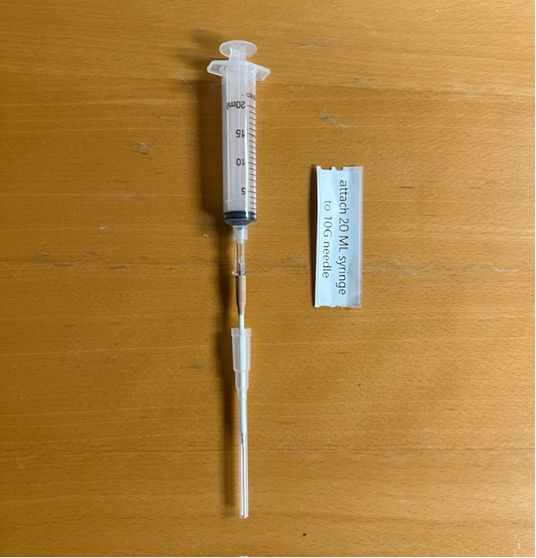
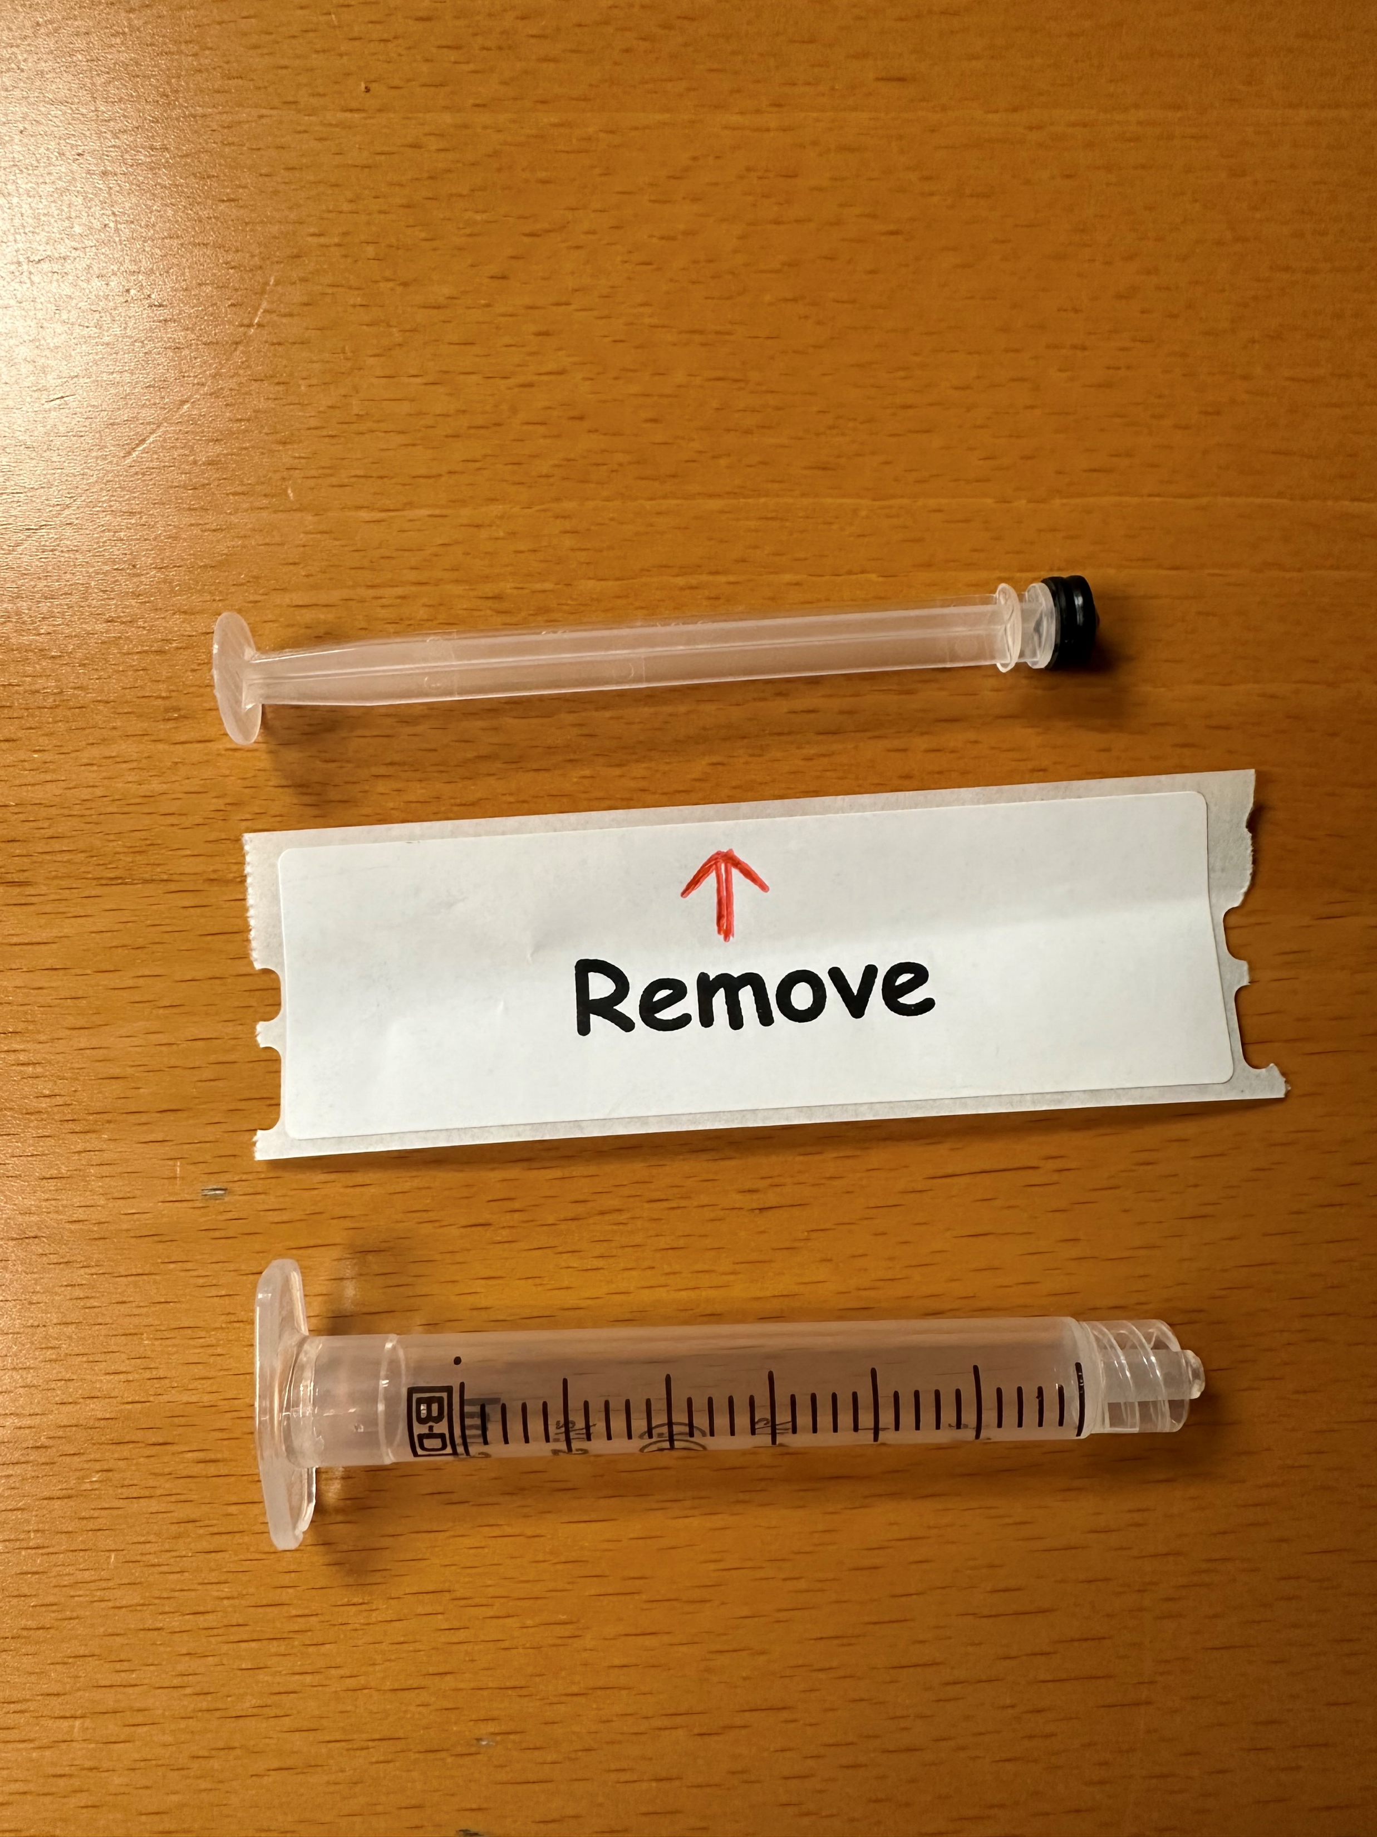
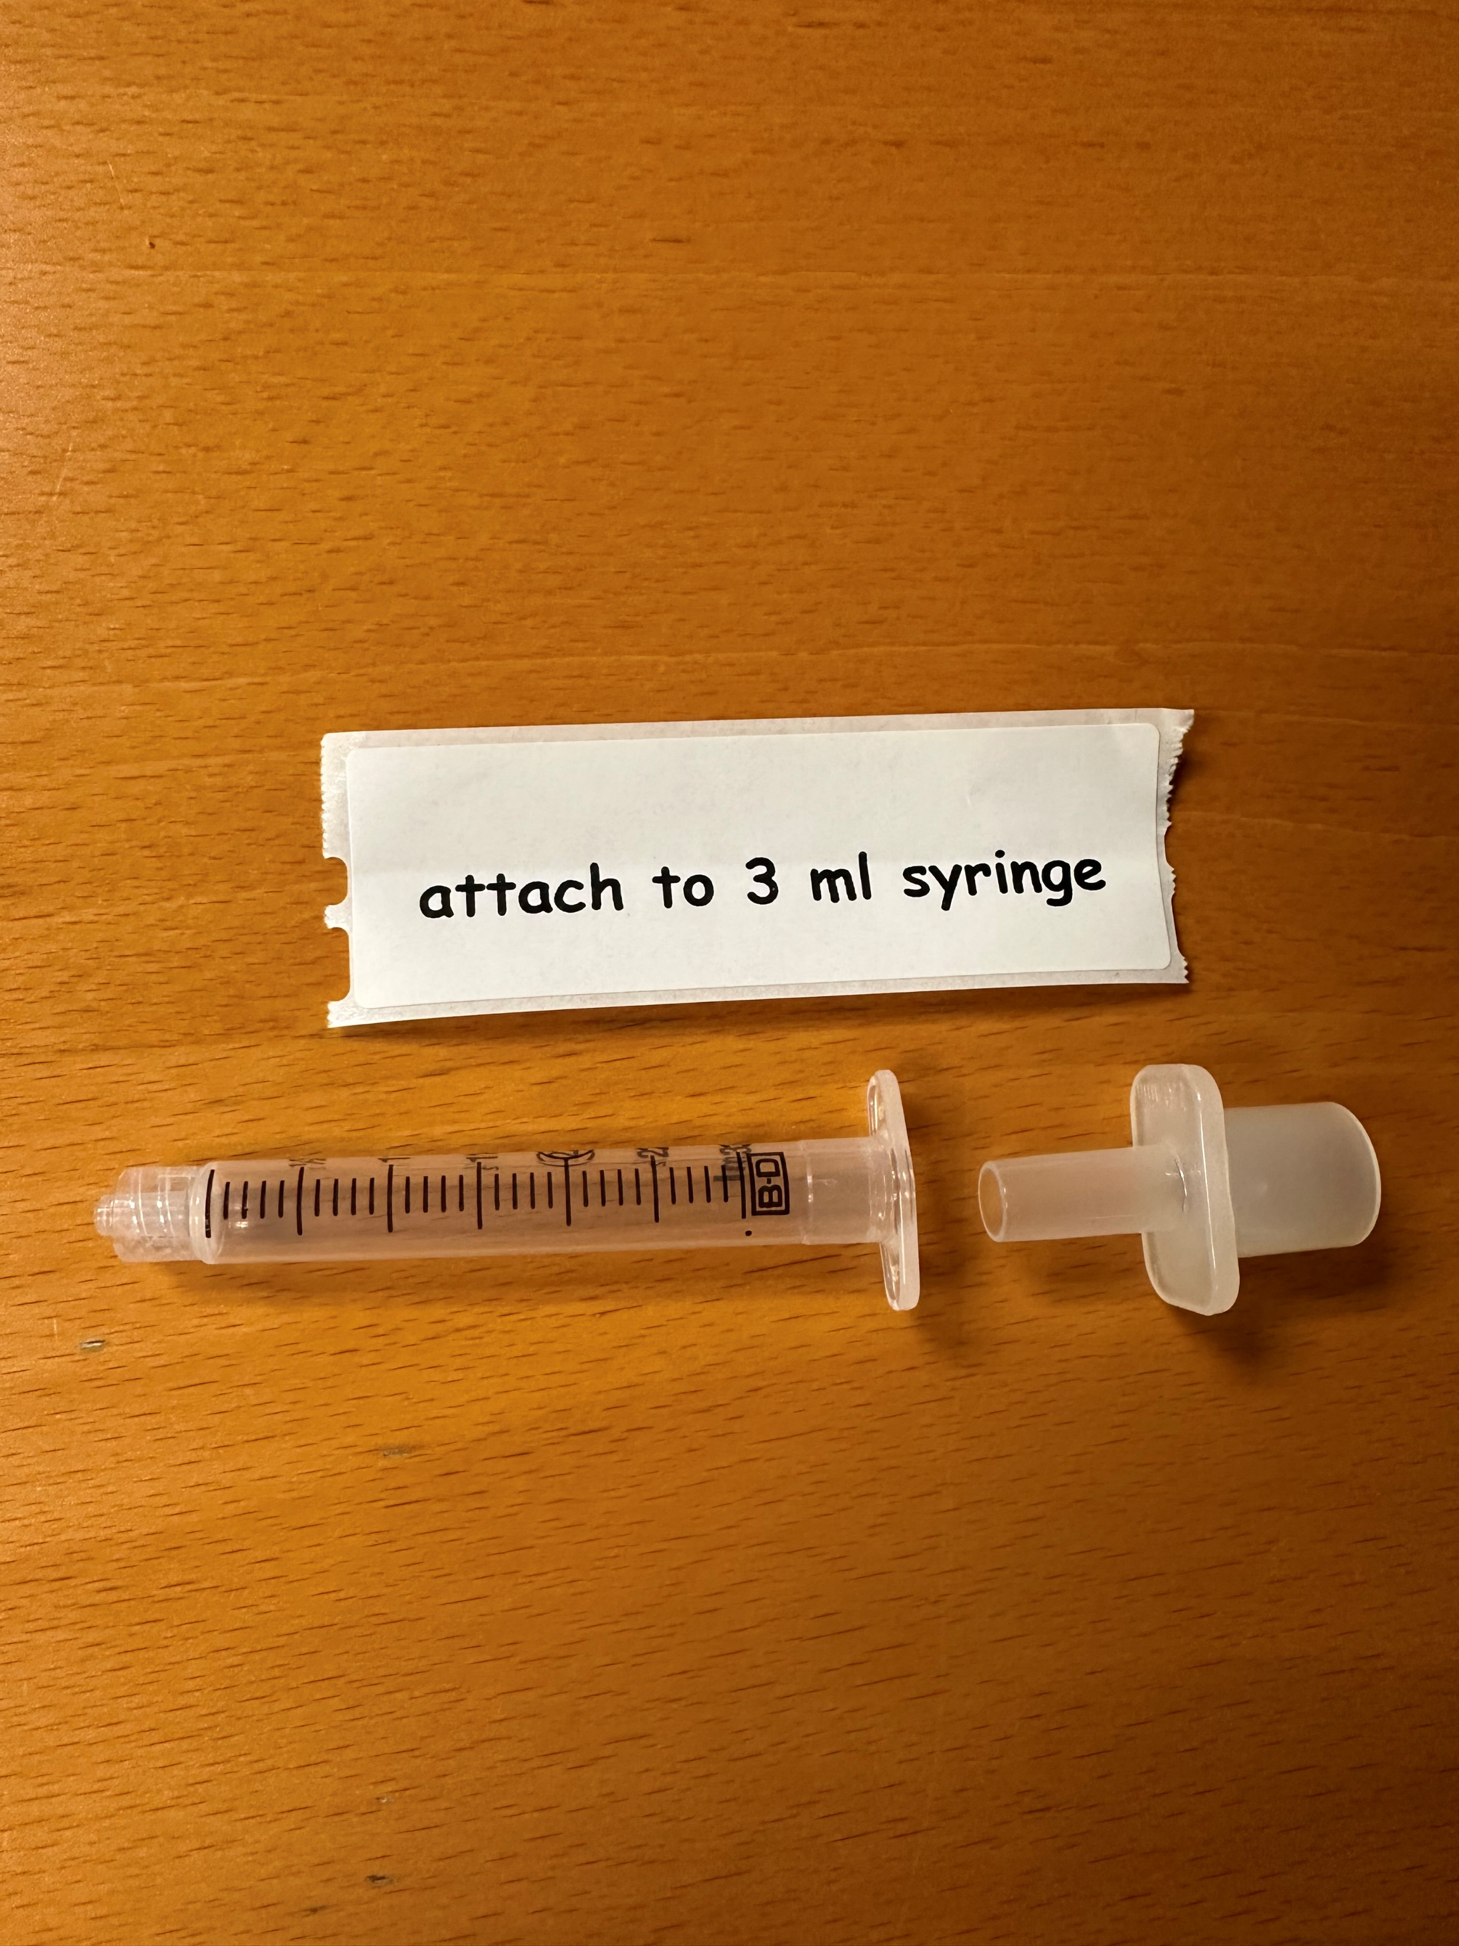

Prepare equipment
Attach 20 mL syringe to 10 GA 3.00 Inch angiocath (acts as EDD)
Attach ETT adapter to 3mL syringe
Remove plunger from 3mL syringe
Notes:
Edd is the Esophogeal Detector Device. During procedure they should be able to aspirate air without difficulty

Slide 18
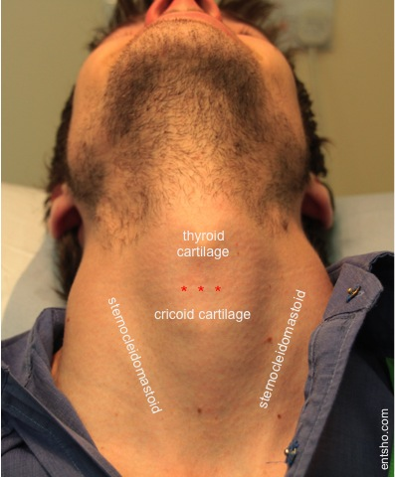
Prepare the patient
Position supine w/padding to extend neck unless contraindicated
Attempt to preoxygenate for 3 min 15L BVM
Avoid high pressure & gastric distention with BVM
Notes:
Set your self up for success by placing the patient correctly

Slide 19
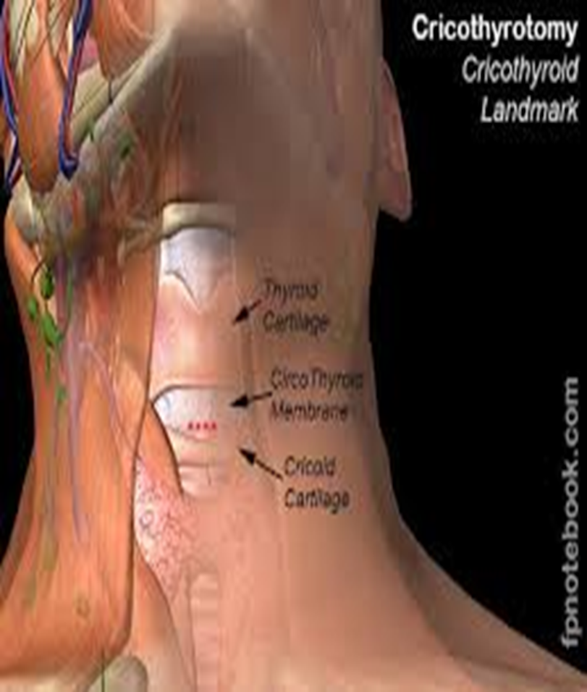
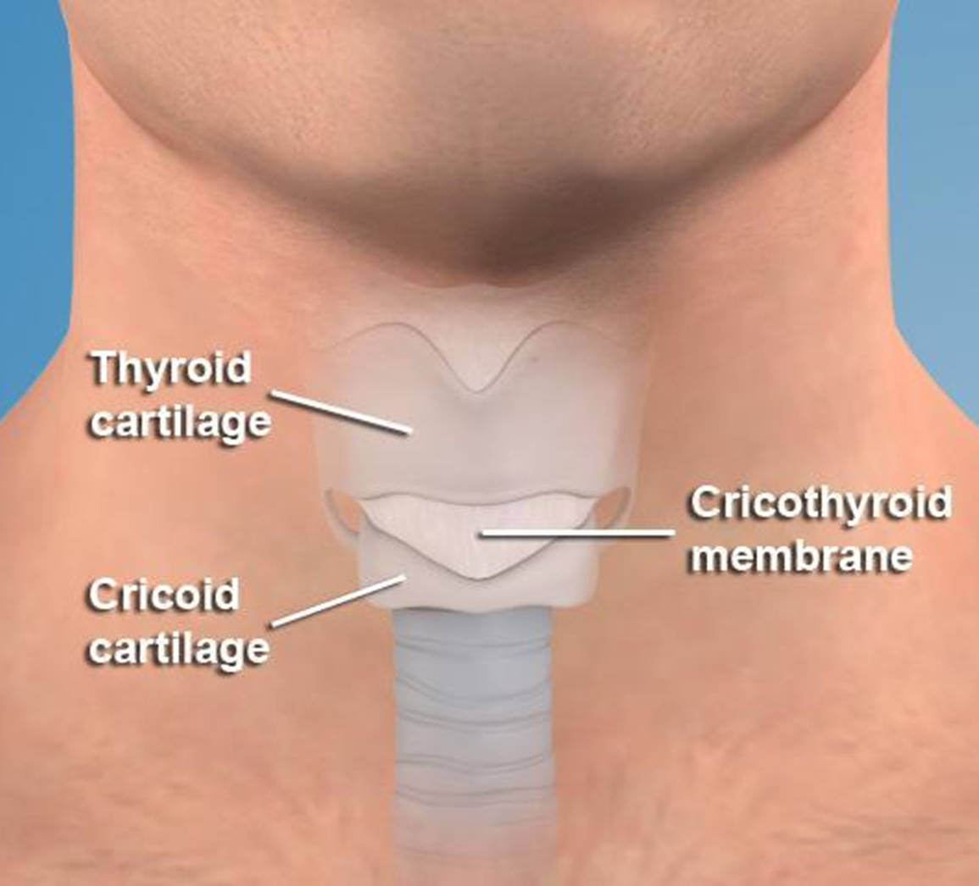
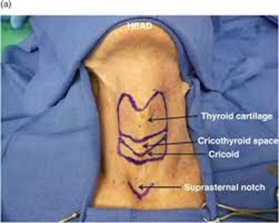
Procedure #1 identify landmarks
Palpate thyroid & cricoid cartilages superiorly & cricoid cartilage inferiorly with thumb & middle finger
Locate Cricothyroid membrane with index finger
Right handed work from right side
Left handed work from left side

Slide 20
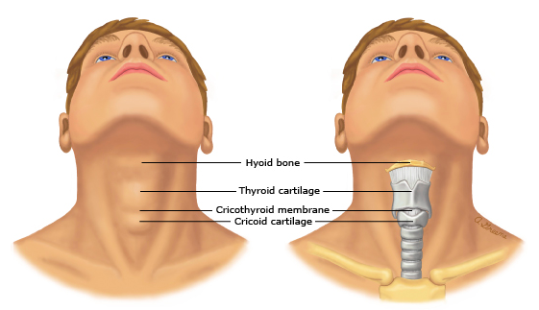
Perform the procedure
Palpate thyroid & cricoid cartilages and prep skin
Locate anatomical landmarks
Thyroid cartilage superiorly
Cricoid cartilages inferiorly
Locate membrane
Right handed work from Pt’s right side
Left handed work from Pt’s left side

Slide 21
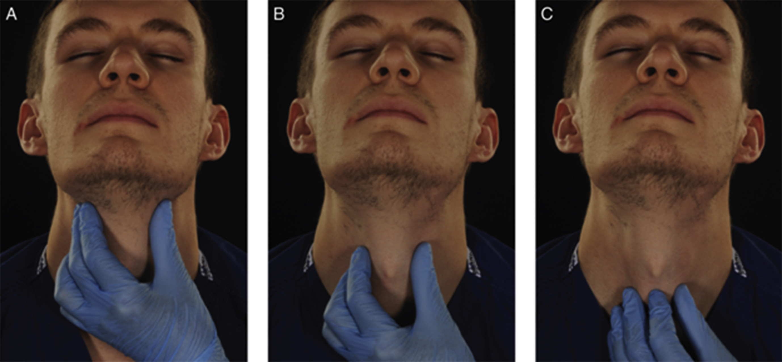
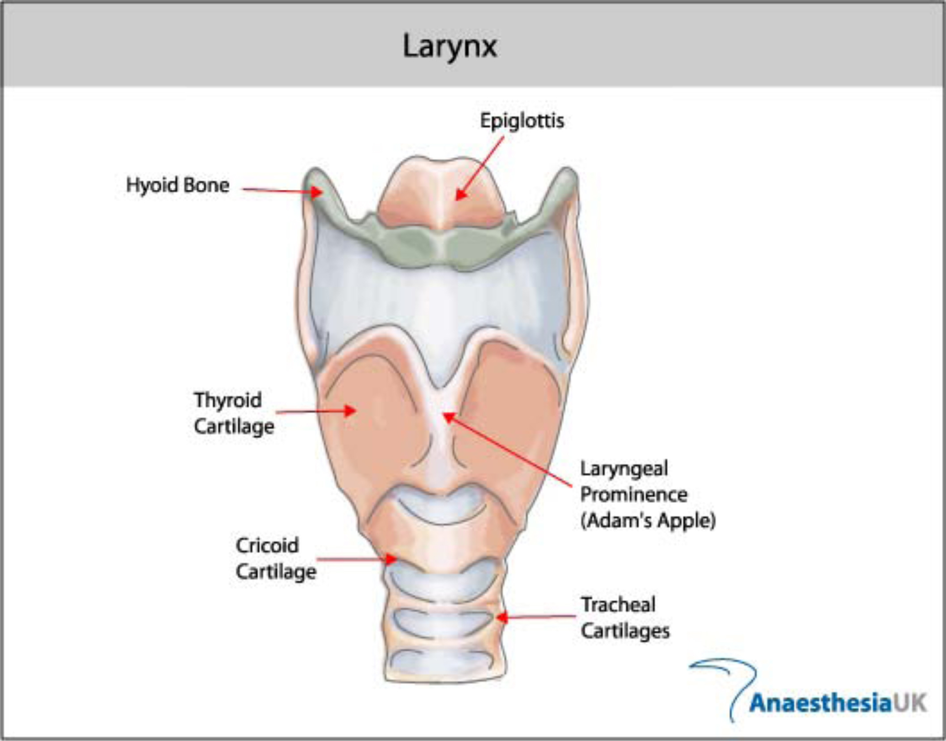
The laryngeal handshake is performed with the non-dominant hand, identifying the hyoid and thyroid cartilage, stabilizing the larynx between thumb and middle finger, and moving down the neck to palpate the Cricothyroid membrane with the index finger
Notes:
Have each person identify the Cricothyroid membrane on themselves.

Slide 22
Perform procedure
Prep skin with CHG/IPA as you would IV or IO
Insert needle through the membrane at a 90-degree angle to the skin through the midline of the membrane using firm downward pressure until a “POPPING” sensation is felt
When resistance abruptly ceases stop advancing needle
Aspirate air into the 20 mL syringe to confirm tracheal placement.
SHOULD ASPIRATE EASILY

Slide 23
Perform Procedure
Angle needle tip towards chest at a 20-45 degree angle
Hold needle and advance the catheter over the needle to its hub (like an IV)
When catheter fully advanced, withdraw needle and place into a sharps
Attach the 3mL syringe with ETT adapter attached to the hub of catheter
Apply capnography to the ETT adapter
Ventilate slowly Pediatric BVM 10/BPM
Allow 4 seconds for exhalation / if upper airway obstructed allow 8 seconds of exhalation
May need to manually compress chest to assist exhalation
Notes:
Gently compress chest during exhalation if needed… stress to only compress during exhalation

Slide 24

Confirm placement
Auscultate epigastrium , both midaxillary and anterior chest x2
Assess capnography
Secure catheter in place using tape
Control bleeding as needed
If incorrectly placed ………..troubleshoot determine error and take corrective action

Slide 25

Frequently monitor EtCO2, SpO2, VS, & lung sounds enroute
Looking to detect:
displacement
complications
condition change
monitor insertion site for complications

Slide 26
Video
https://youtu.be/u05uhVzzWPU
Notes:
https://youtu.be/u05uhVzzWPU

Slide 27
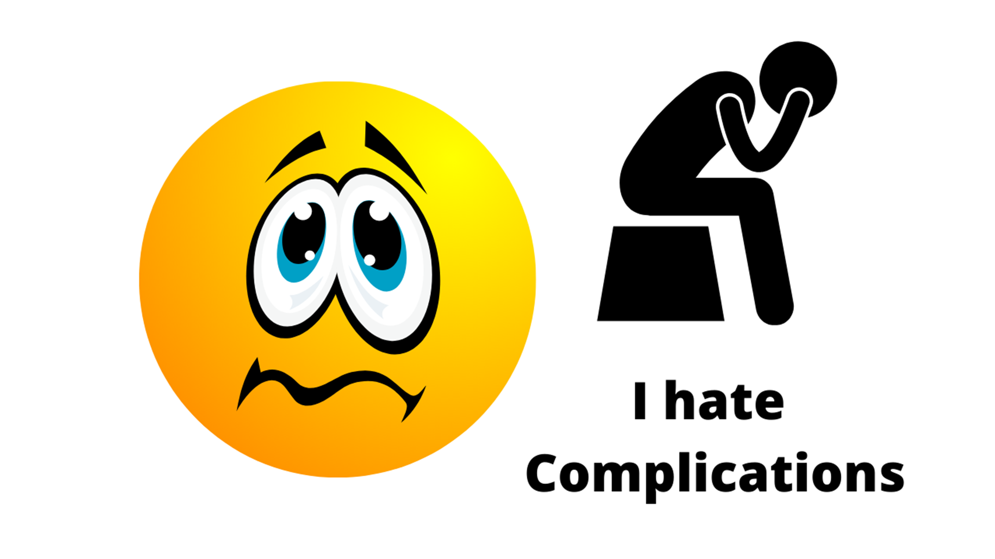

Slide 28

Complications
High pressure during ventilation and air entrapment may produce pneumothorax
Hemorrhage at the insertion site
Thyroid gland & esophagus can be perforated if needle is inserted inappropriately and or advanced to far
Subcutaneous emphysema
Hypercarbia
Because of inadequate exhalation CO2 accumulates and limits the long-term use of this approach
This technique can adequately oxygenate for 30 – 40 minutes
Catheter dislodgement

Slide 29


Slide 30


Slide 31

https://create.kahoot.it/share/airway-24/ac03fdd0-e35b-46c7-b92e-4b026856e077
Notes:
https://create.kahoot.it/share/airway-24/ac03fdd0-e35b-46c7-b92e-4b026856e077
password #Love2018
valeriezage@gmail.com username

Slide 32
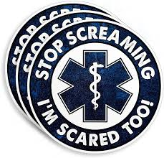
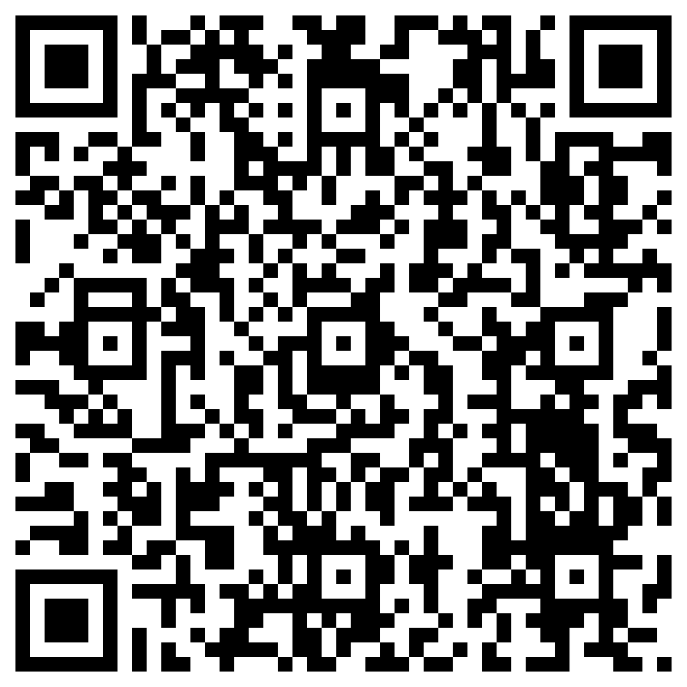
Evaluations Please!

Slide 33
References
Laryngeal handshake technique…..comparative study PMID: 30336863 DOI: 10.1016/j.bja.2018.07.034
Levitan, the “Laryngeal Handshake” and the “Cartilaginous Cage” – Prehospital and Retrieval Medicine – THE PHARM dedicated to the memory of Dr John Hinds (prehospitalmed.com)
Carbon Dioxide Narcosis Michael Drechsler; Jason Morris 2023
Fortune JB, Judkins DG, Scanzaroli D, McLeod KB, Johnson SB. Efficacy of prehospital surgical cricothyrotomy in trauma patients. J Trauma. 1997 May. 42(5):832-6; discussion 837-8. [QxMD MEDLINE Link].
Avva U, Lata JM, Kiel J. Airway Management. [Updated 2023 May 19]. In: StatPearls [Internet]. Treasure Island (FL): StatPearls Publishing; 2024 Jan-. Available from: https://www.ncbi.nlm.nih.gov/books/NBK470403/
Harless J, Ramaiah R, Bhananker SM. Pediatric airway management. Int J Crit Illn Inj Sci [serial online] 2014 [cited 2017 Dec 3];4:65-70. Available from: http://www.ijciis.org/text.asp?2014/4/1/65/128015
Comparison of the Conventional Downward and Modified Upward Laryngeal Handshake Techniques to Identify the Cricothyroid Membrane: A Randomized, Comparative Study. Anesth Analg. 2021 Sep 13. doi: 10.1213/ANE.0000000000005744. Online ahead of print.

