Slide 1
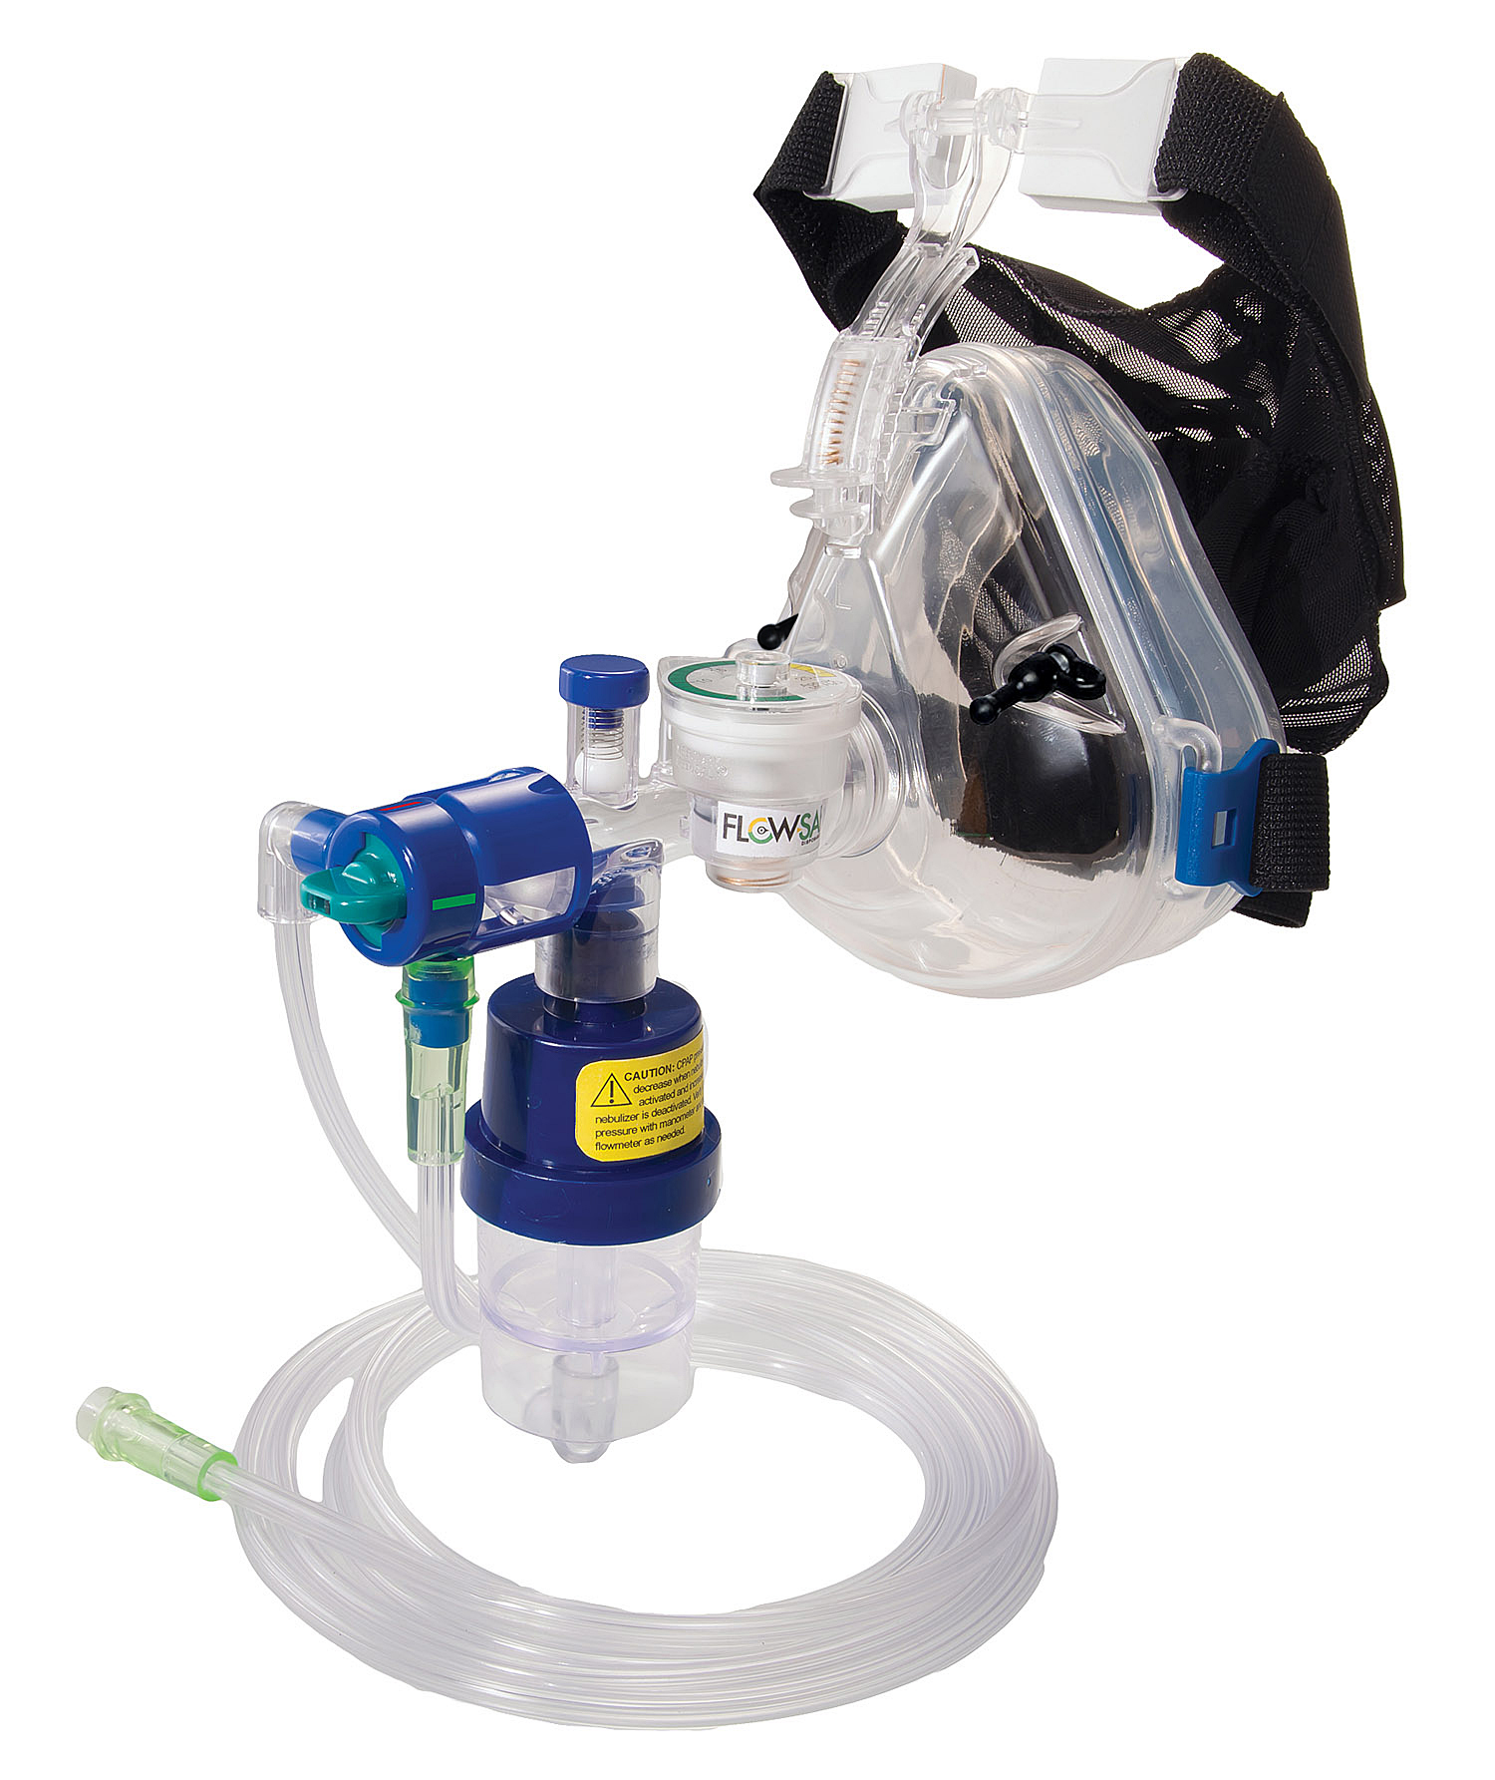
FLOW-SAFE II ez CPAP System with Integrated Nebulizer E Depouw MSN, PHRN Northwestern McHenry Western Lake County EMS

Slide 2
Advantages
Uses only one oxygen supply source
Easy set-up
Consumes 50% less Oxygen than original Flow-Safe
Built in Manometer & Pressure Relief valve
Manometer for verified pressure readings
Relief valve automatically adjusts to avoid excess pressure
Design of mask is lighter, easier to handle, and better anatomical seal
Can be used as CPAP WITHOUT the nebulizer.
Leave knob in the OFF position

Slide 3
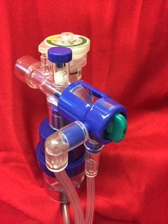
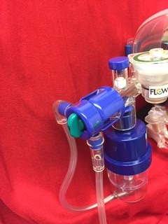
The FLOW-SAFE II ez CPAP System with Integrated Neb is packaged in the Off position
OFF Position
OFF Position
Off Position Green knob to the red line

Slide 4
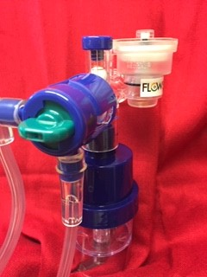
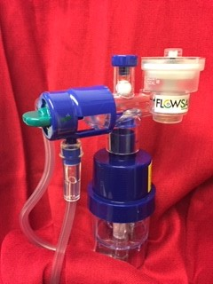
To activate nebulizer rotate knob to the ON position
On Position
ON Position
On position green knob to green line

Slide 5
Which position is this in ON or Off?
ON

Slide 6
Which position is this in ON or Off?
OFF

Slide 7
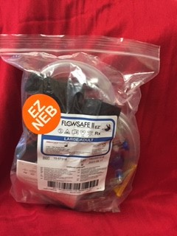
Which position is this in ON or Off?
OFF
The FLOW-SAFE II ez CPAP System with Integrated neb is packaged in the Off position

Slide 8

How many oxygen sources do you need with the FLOW-SAFE II ez CPAP System with Integrated Nebulizer????

